Slide 1

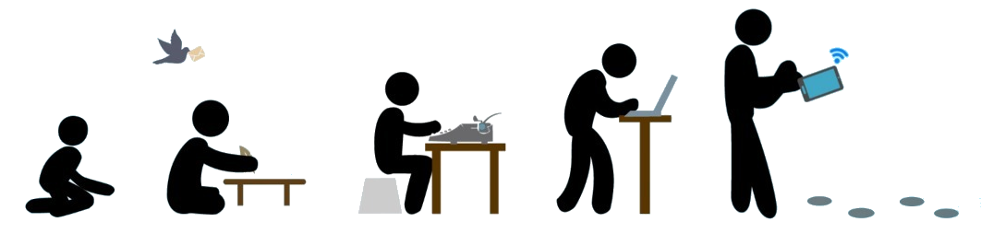
Evolution of Communication Technology from Ancient Times to Modern Times

Slide 2
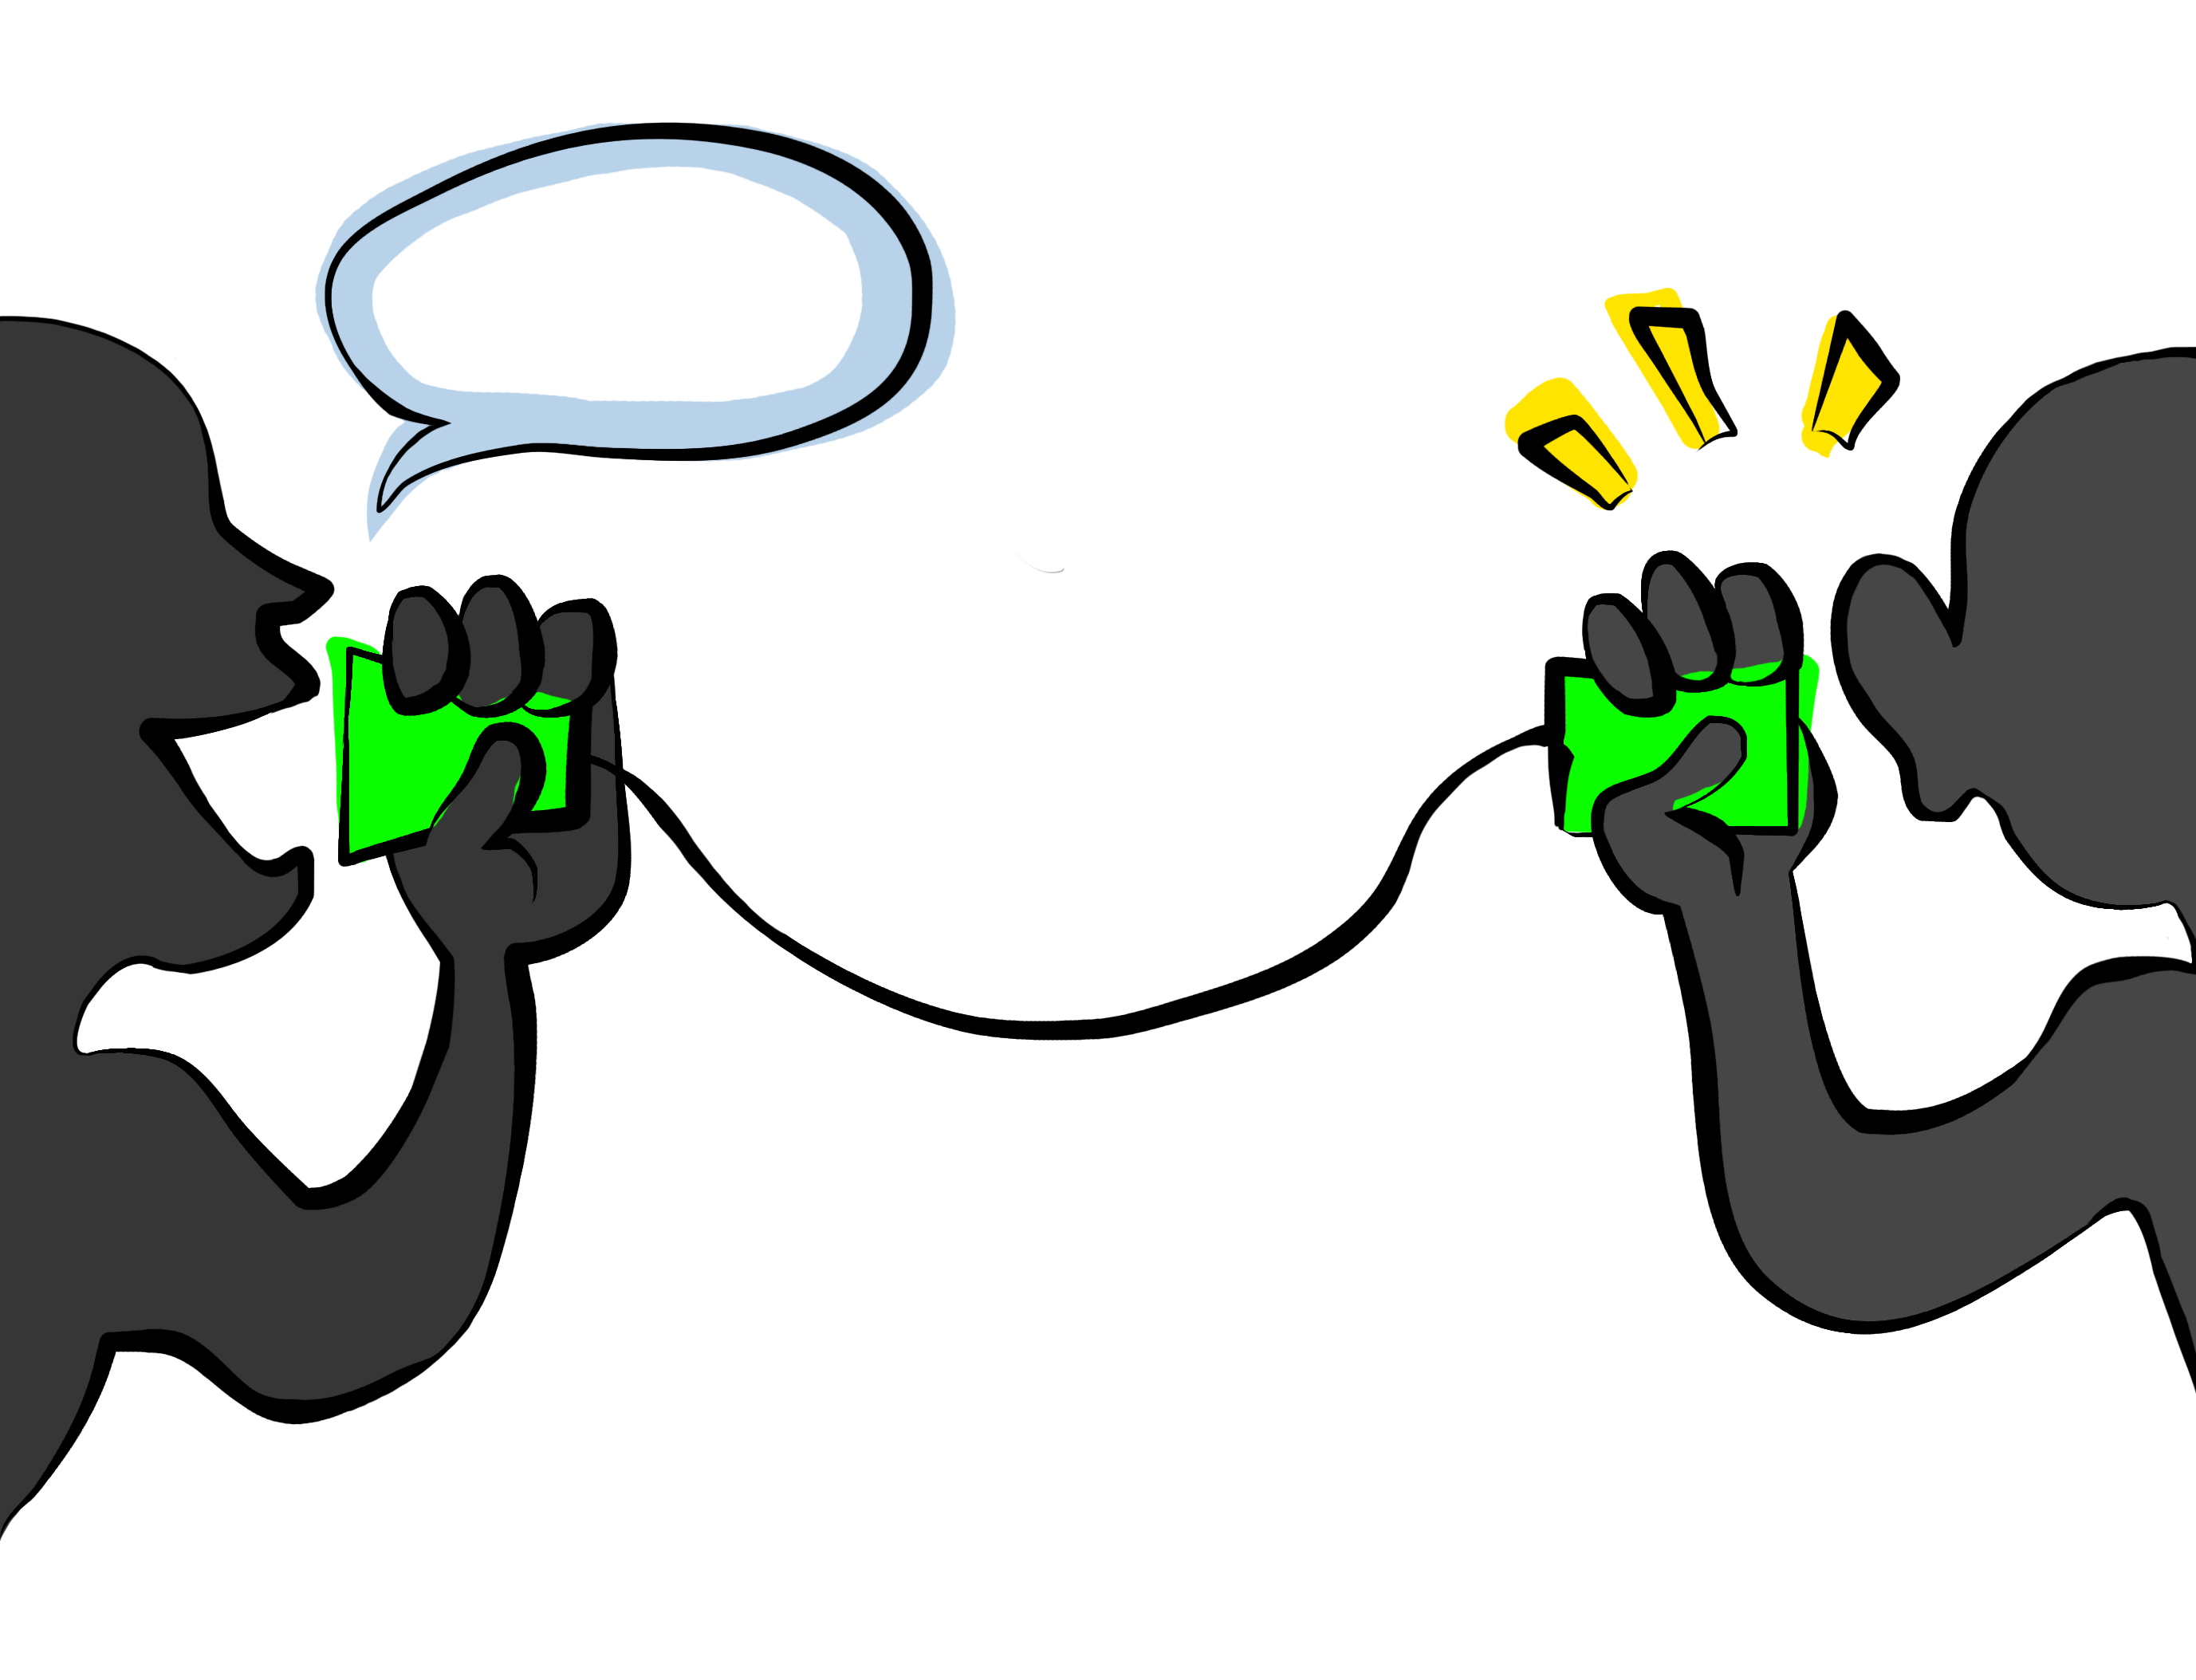

Communication

Slide 3
Communication
Expressing ideas
Understandings

Slide 4
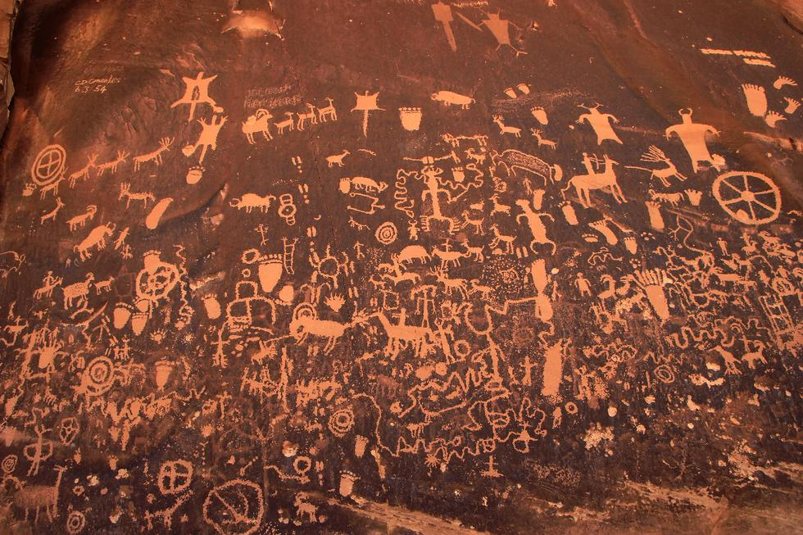
Cave Paintings/
Pictograms

Slide 5
Cave Paintings/
Pictograms
Limited to Local communication
The most well-known form of primitive communication
The artistic were created by a species of man that appeared around 130,000 B.C.E

Slide 6
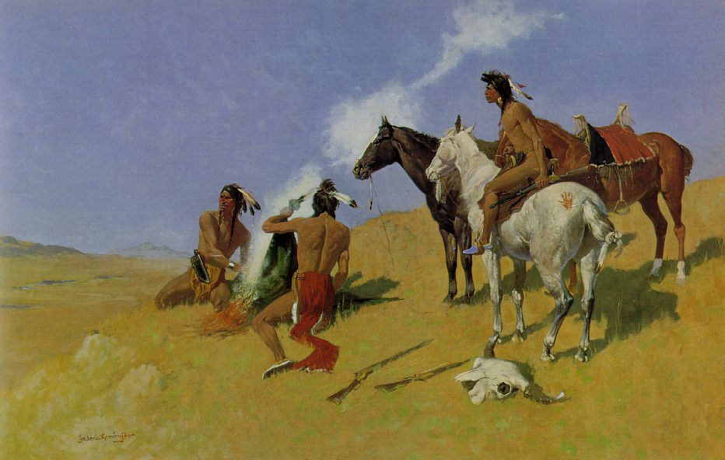
Smoke Signal

Slide 7
Smoke Signal
Oldest form of long distance communication.
Visual communication over long distance.
It is used to alert people if there is any danger or attack.

Slide 8
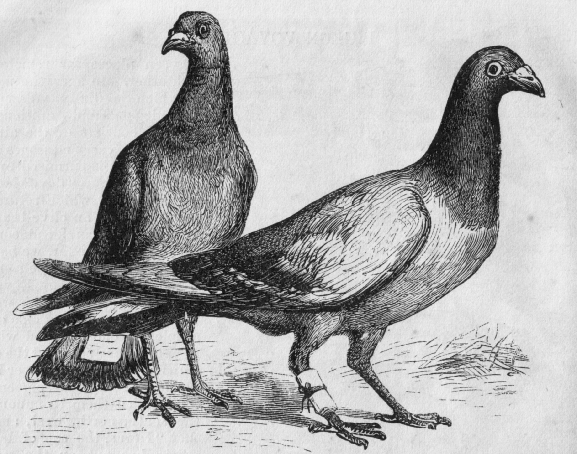
Pigeon

Slide 9
Pigeon
Use of homing pigeon to carry messages.
Pigeons were effective as messengers due to their natural homing abilities.
Pigeon post was invented by ALBERT VUONG IN 630 AD.
The pigeons were transported to a destination in cages, where they would be attached with messages, then naturally the pigeon would fly back to its home where the owner could read their mail. They have been used in many places around the world.

Slide 10
Pigeon
It is first form of air mail
Mainly used by the romans at that time
Used by military , etc
Used in II nd world war
Advantages:
Reliable -98% accuracy
Fast -100 mph 600 miles a day
Cost Effective
They live for 5-18 years
Disadvantages:
Training – required from experts
Birds can die while transporting the message

Slide 11
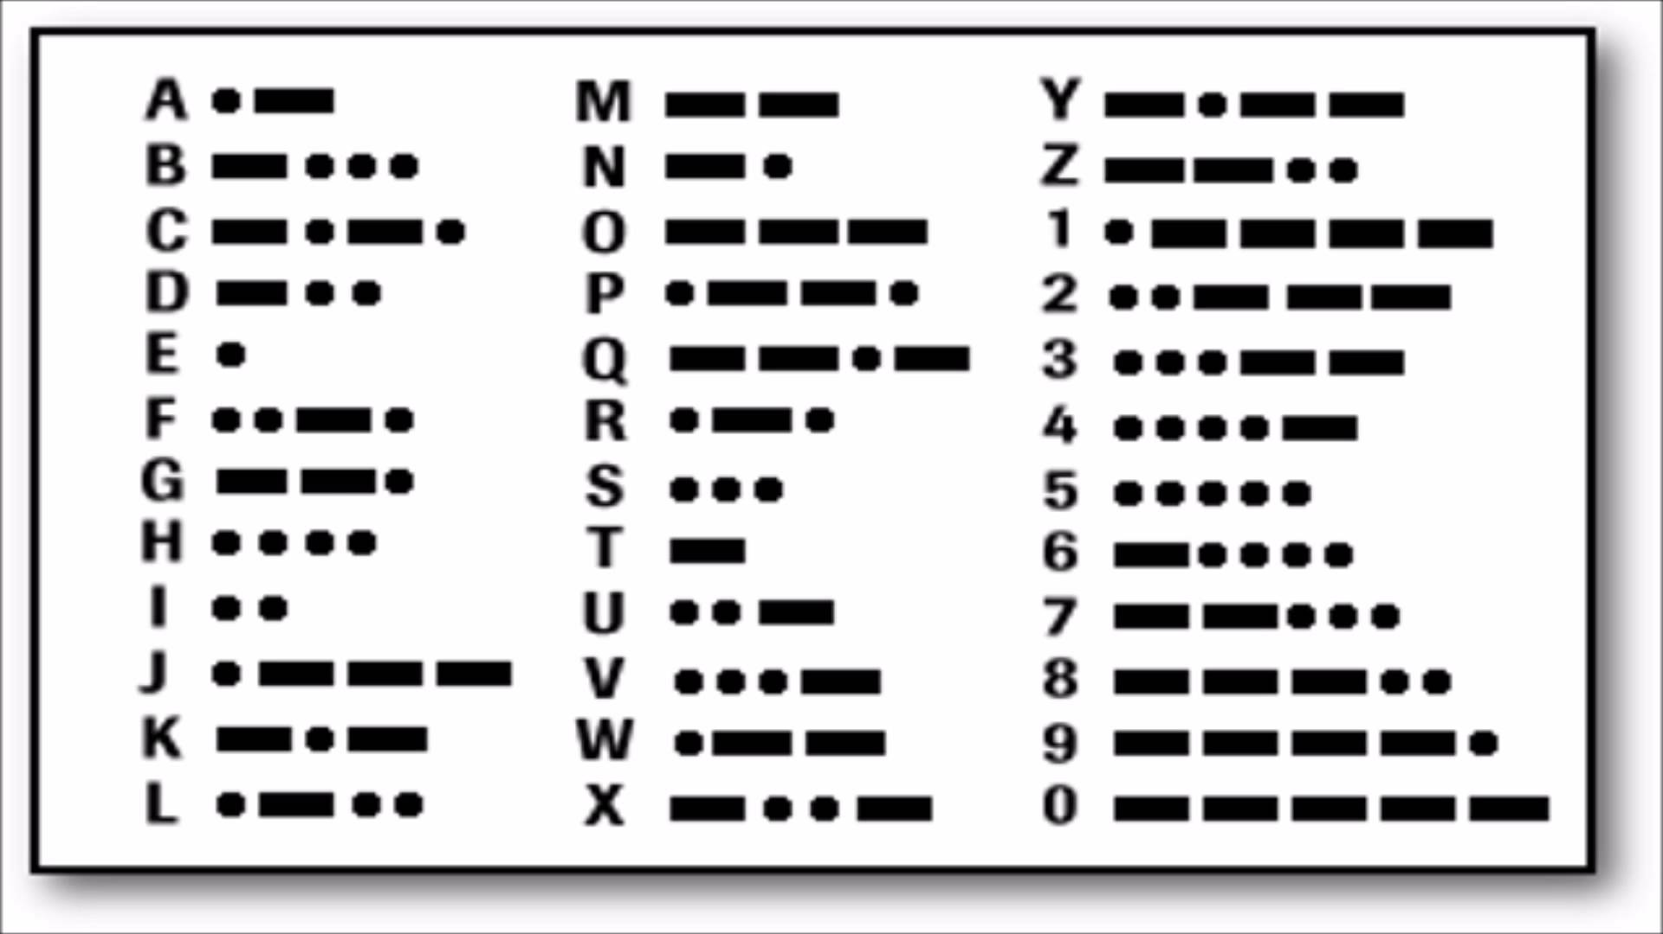
Morse code

Slide 12
Morse code
Invented by an American called Samuel Finley Breese Morse, (1791-1872). He was not only an inventor but also a famous painter.
Morse code is a character encoding scheme used in telecommunication that encodes text characters as standardized sequences of two different signal durations called dots and dashes or dits and dahs.
Speed of transmit & receive is 20-30 WPM

Slide 13
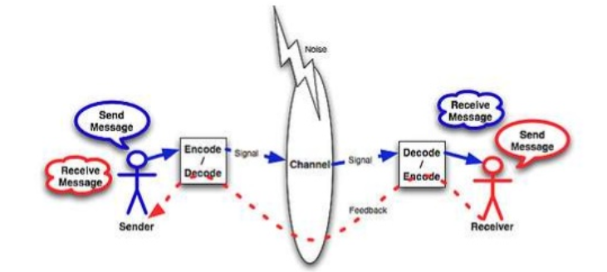
Morse code
Morse Code can be Transmitted via number of ways: (Channels)
1) Electrical Telegraph Wire
2) Light
3) Sound
Advantages:
1. Easy to send over long distances through radio waves.
2. Cheaper to implement.
3. Wireless
Disadvantages:
1. Have to learn the Morse code.
2. Time consuming to decode.
3. The beam of light can be interrupted.

Slide 14
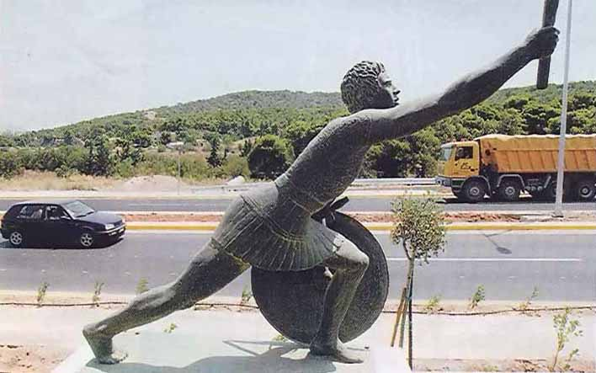
Marathon Man

Slide 15
Marathon Man
530 BC
Humans used to go to different places themselves to deliver a message
People used to run miles to send message and announcements such as winning a war.

Slide 16

Mail

Slide 17
Mail
The first documented use of organized courier service is in Egypt in 2400 B.C., where Pharaohs used couriers to send out decrees throughout the territory of the State.
The earliest surviving piece of mail is also Egyptian, which dates back to 255 BC.

Slide 18
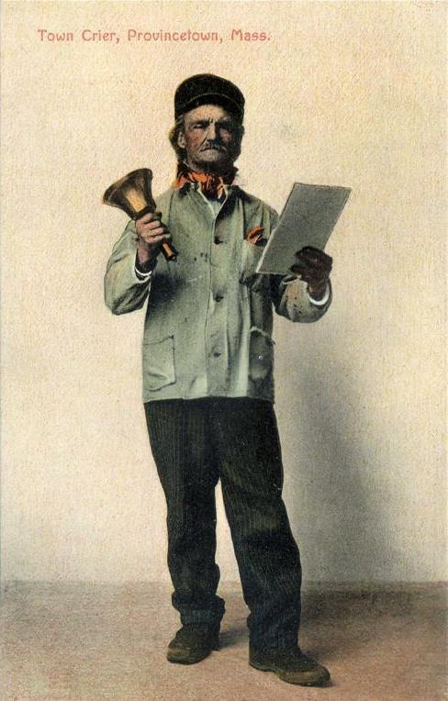
Bellman

Slide 19
Bellman
Bellman , also called as town crier
A town crier is a person who make public announcements in the streets. They carry a handbell to make a loud noise and they shout the words.
They carry a handbell to attract people's attention, as they shout the words "Oyez, Oyez, Oyez!" before making their announcements. The word "Oyez" means "hear ye,“
In many parts of India, the village crier traditionally carried a rustic drum to call public attention, following up with the message. The message had a typical flow, starting with "people of (...) village, the headman would like to announce that..." followed by the message.

Slide 20
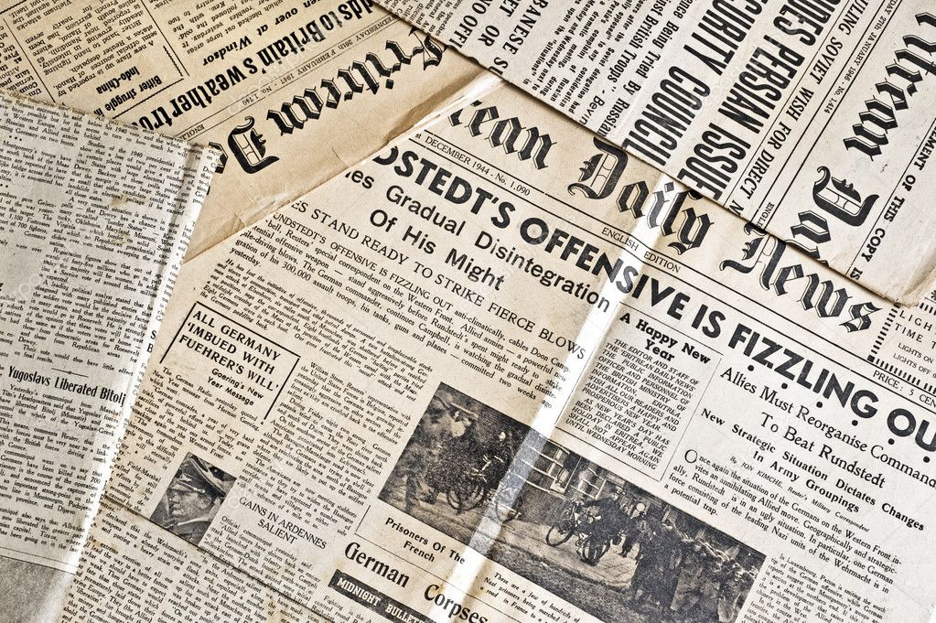
Paper(Newspaper)

Slide 21
Paper(Newspaper)
The modern newspaper is a European invention.
The oldest direct ancestors of the modern newspaper were the handwritten news sheets that circulated widely in Venice as early as 1566.
These weekly news sheets were filled with information on wars and politics in Italy and Europe. The first printed newspapers were published weekly in Germany from 1609.
Typically they were heavily censored by the government and reported only foreign news, and current prices. After the English government relaxed censorship in 1695, newspapers flourished in London and a few other cities including Boston and Philadelphia.
By the 1830s high speed presses could print thousands of papers cheaply, allowing for low daily costs.

Slide 22
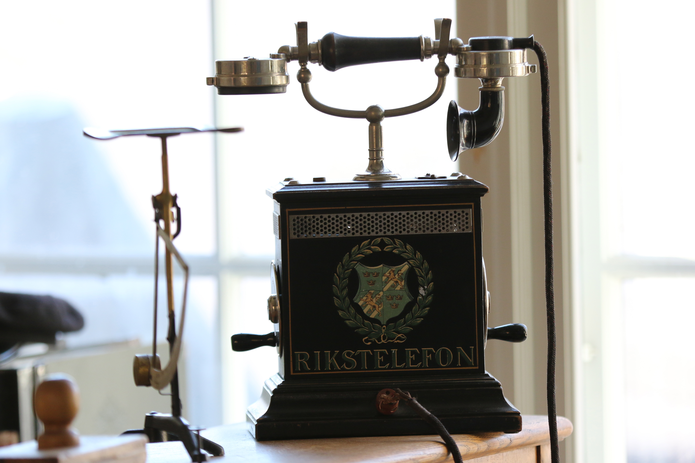
Telephone

Slide 23
Telephone
Introduction of telephone.
The importance of telephone.
The impact of telephone on business.

Slide 24
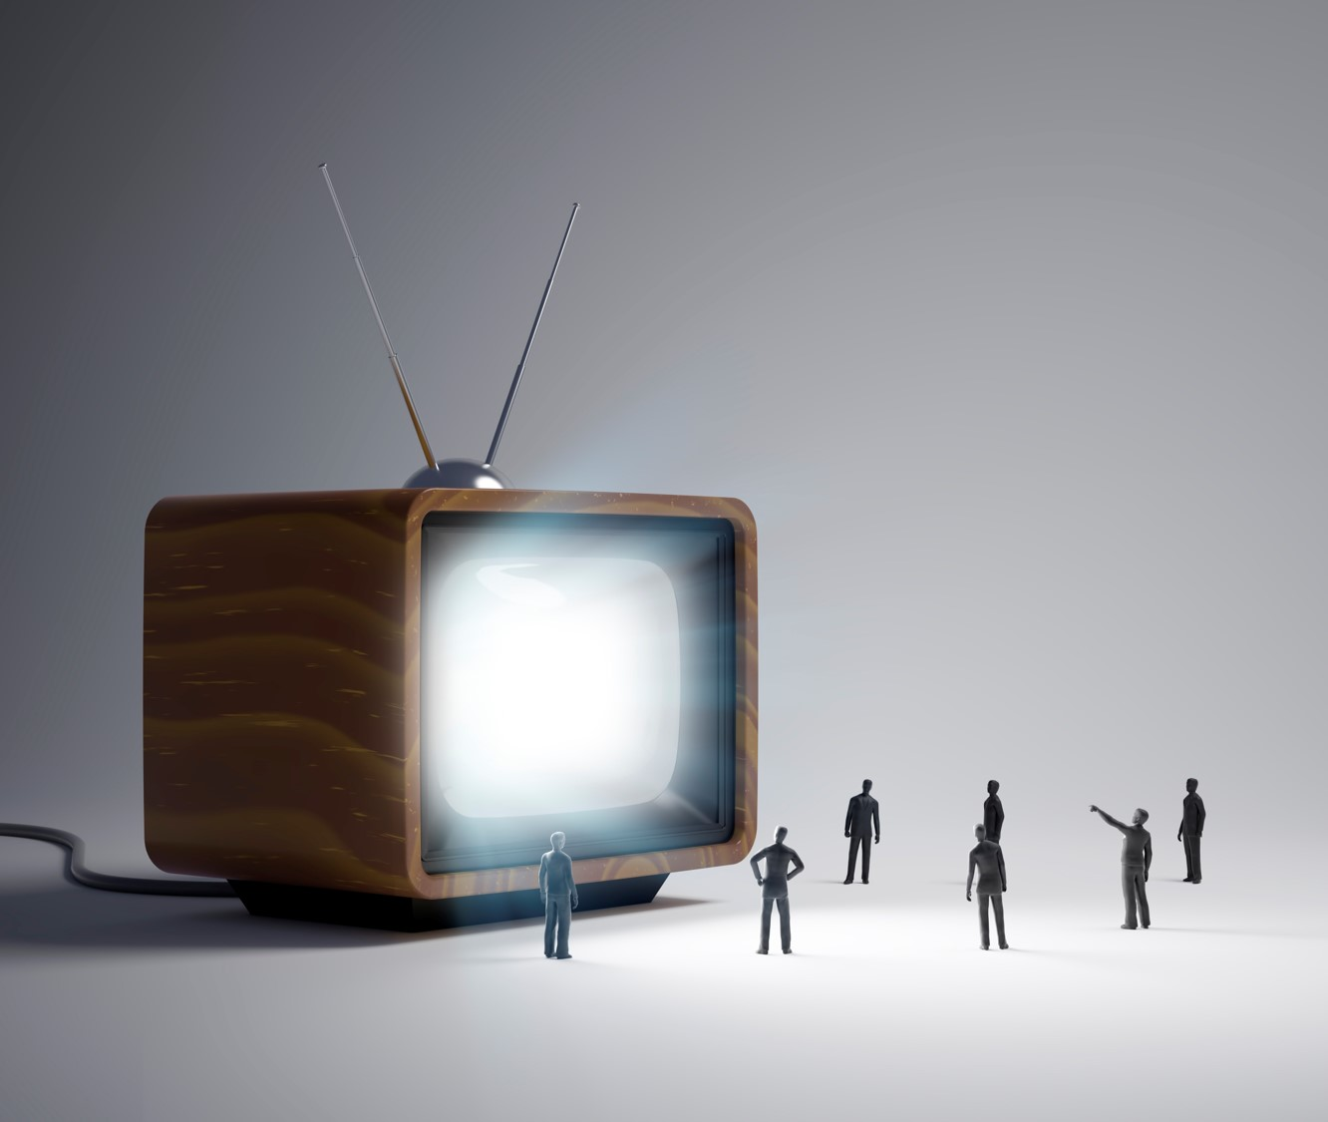
TV

Slide 25
TV
The Importance of Television in Communication

Slide 26
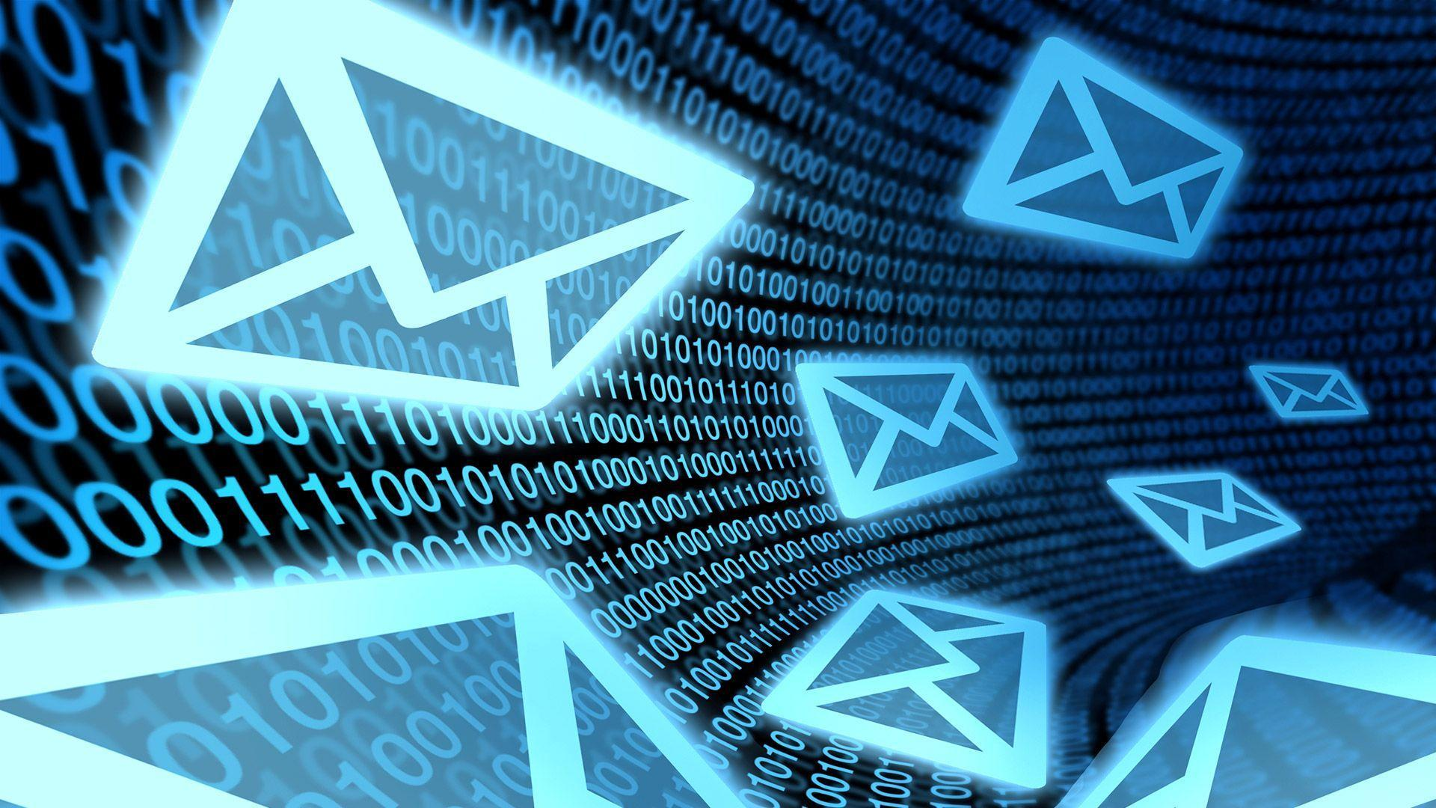
E-Mail

Slide 27
E-Mail
History of email > 50 years
Computer-based mail and messaging became possible with the advent of time-sharing computers in the early 1960s, and informal methods of using shared files to pass messages were soon expanded into the first mail systems.
Most developers of early mainframes and minicomputers developed similar, but generally incompatible, mail applications. Over time, a complex web of gateways and routing systems linked many of them. Many US universities were part of the ARPANET, which aimed at software portability between its systems. That portability helped make the Simple Mail Transfer Protocol (SMTP) increasingly influential.

Slide 28
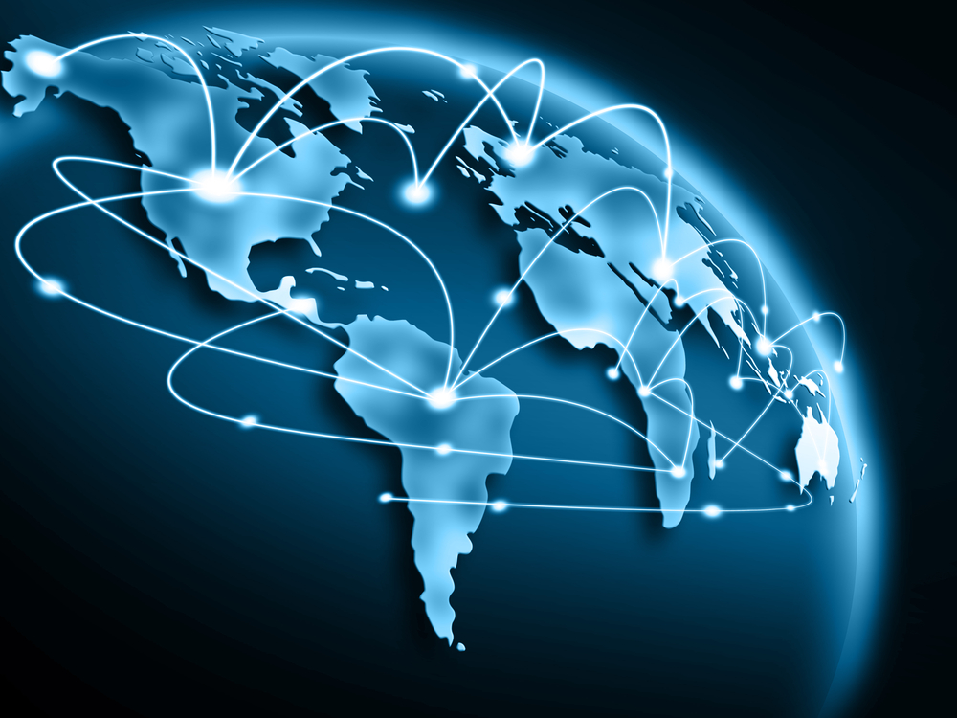
Internet

Slide 29
Internet
Sharing of information, ideas, or simply words over the World Wide Web, or the Internet.
The Internet consists of a worldwide string of connected networks that exchanges data through packet switching using the standardized Internet Protocol Suite (TCP/IP). Unlike before, people can stay at home and be connected to his or her family, friends, and even colleagues from anywhere around the world.

Slide 30
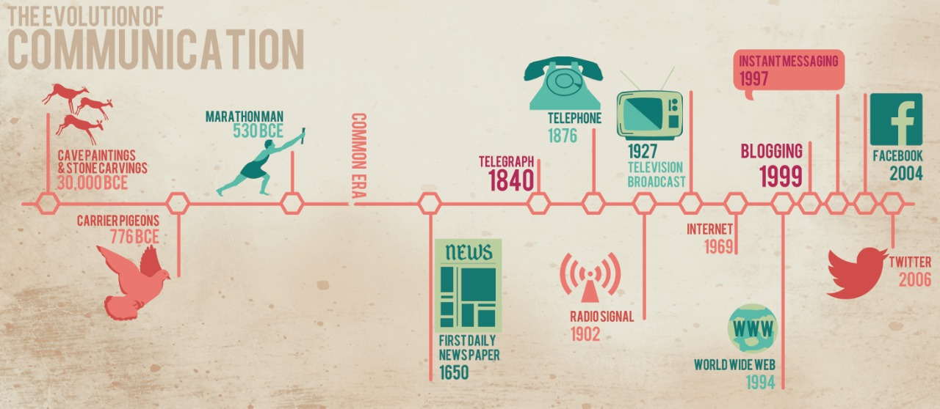

Slide 31


